Slide 1

Healthcare expenditures of individuals
Healthcare expenditures of individuals
Raul SARBU
Bogdan TATU
Story MEPS 7

Slide 2
Healthcare expenditures of individuals
Healthcare expenditures of individuals
Raul SARBU
Bogdan TATU
Story MEPS 7

Slide 3
01
Introduction
Annual Healthcare Expenditure of Individuals
Notes:
In this presentation, we'll discuss models predicting annual healthcare expenditures based on MEPS large-scale surveys, using XAI algorithms for model diagnostics and understanding relationships.

Slide 4
Observations
01
02
03
04
14% Healthcare Expenditure = 0
Errors in data collection
Self-reported health status data misleading
Rapid growth at specific ages
SHAP application on complex models
Encoding
Grouping
categorical variables
Notes:
Key observations include potential errors in data collection, the importance of carefully designing methodologies for self-reported health status data, and the relationship between age and healthcare expenditures. Lastly, we'll explore the use of SHAP in complex models, which can improve performance, stability, and interpretability in simpler models.

Slide 5
02
The MEPS Dataset
Notes:
Now let’s discuss the dataset that we’ve used

Slide 6
Medical Expenditure Panel Survey
Families
Individuals
Medical Providers
Employers
Large Scale Surveys
18350 observations
Notes:
Meps is used to analyze healthcare expenditures based on demographic and socio-economic factors.
The data, obtained through IBM's AIX360 and contains 18,350 observations

Slide 7
Data
Variable | Description
Demographics | Age, gender, marital status
Socio-Economics | Education, income, insurance coverage
Self-Reported Health Status | Self-evaluation of physical and mental health status
Diagnoses | Stroke, cancer, heart disease, diabetes
Health Limitations | Cognitive, activity, sensory
Notes:
It has variables describing demographics, socio-economics, self-reported health status, diagnoses, and health limitations and on the right part of the slide you can see more precisely what they refer to

Slide 8
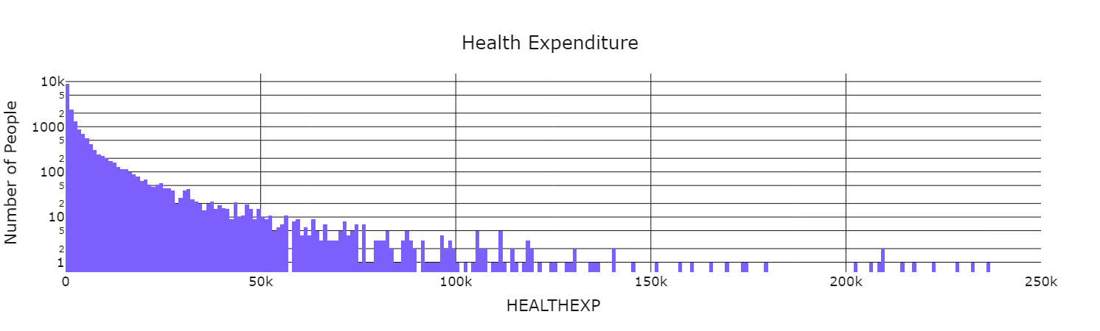
Log Scale of Healthcare Expenditure
For health exp values under 250k
Notes:
Here is the logarithmic scale of healthcare expenditure that we analyzed in our project. We limited it to 250k because of a few outliers.

Slide 9
03
The Model Gradient Boosting
Notes:
The ml model that we used was the gradient boost model.

Slide 10
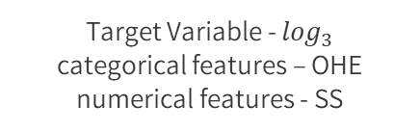
Gradient Boosting XGB
Scikit-learn package
Data Prep
Parameters Optimized
Scikit-learn 2019a
Target Variable - $\log_{3}$
categorical features – OHE
numerical features - SS
n_esimators
max_depth
min_samples_split
min_samples_leaf
Notes:
We have used the scikit learn package and
as was mentioned in Introduction, target variable was transformed with logarithm base 3,
categorical features (i.e. features with 10 or less unique values, except variables “family income”, “perceived health status” and “perceived mental health status” which can be treated as continuous) were transformed with OneHotEncoder (scikit-learn 2019c),
numerical features were transformed with StandardScaler (scikit-learn 2019d).
Also these parameters were optimized

Slide 11
Results
04
Notes:
Now we will talk about what results we obtained.

Slide 12
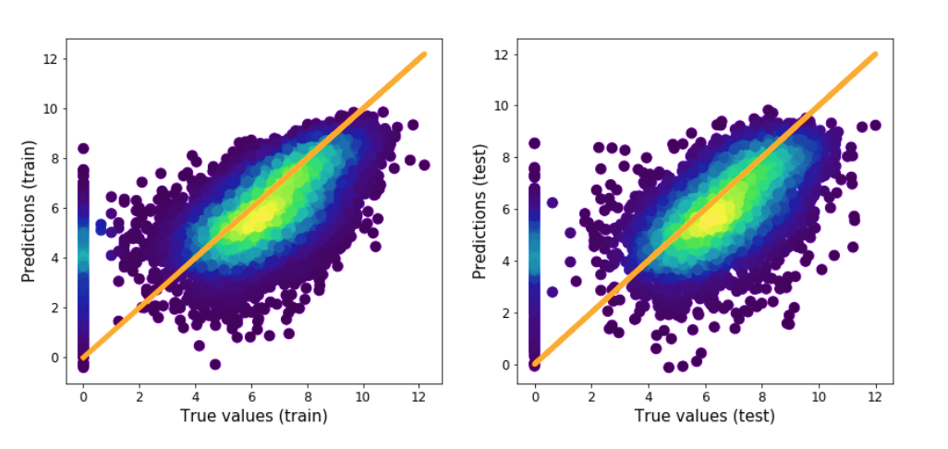
XGB Model
Notes:
These are the scatter plots of predicted and true values for both - training and testing subsets.
We can clearly see a non negligible contribution to the error of observations for which the true value is equal to zero while the predicted one is higher than that.
Let’s find out why

Slide 13
Zero Expenditure
76 years old
$0 Health Expenditure
Woman
$12,005 Predicted
Various health conditions
Notes:
This is a selected observation of a 76-year-old woman with various health conditions and a total health expenditure of zero. Our model predicted an expenditure of $12,005.68, and we aim to understand why. To gain more insight, we'll use LIME to identify the most significant influences on this prediction.

Slide 14
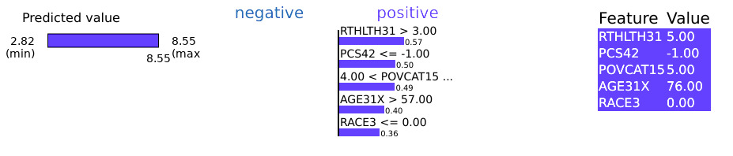
LIME
Poor perceived health status
Self-evaluation - inapplicable
High family income
76 years old
White race
Notes:
The factors with the biggest impact include poor perceived health status, self-evaluation of health, high family income, age, and race.

Slide 15
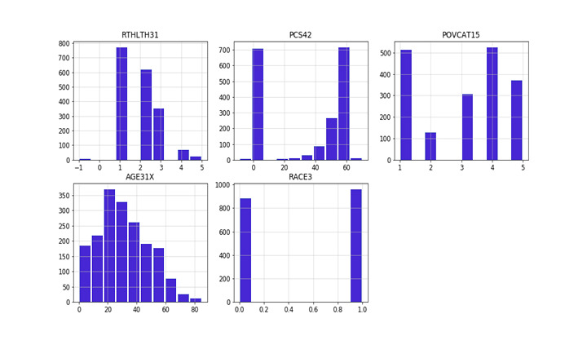
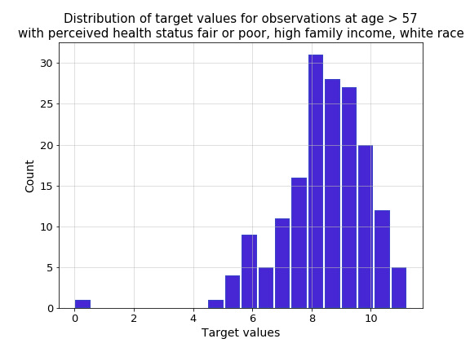
Model Behaviour Analysis
Notes:
the values of PERCEIVED HEALTH STATUS, self-evaluation of health, and age constitute a definite minority.
By using LIME and analyzing distributions, we'll focus on individuals older than 57 with a fair or poor perceived health status, high family income, and white race. From the distribution of target values, we observe that there is only one case with a total health expenditure of zero and the mean value is around 8. Based on these findings, we can conclude that the model's behavior is correct.

Slide 16
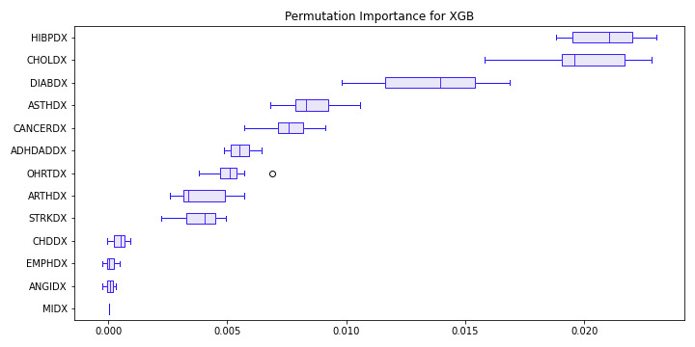
SHAP
Weights - Shapley additive explanations values
Notes:
Now we'll discuss how we used SHAP explanations to encode and group variables within the XGB model. The model is composed of 43 variables, with 13 of them indicating whether a patient was diagnosed with a specific disease. Our goal is to reduce the input size and improve stability by aggregating these 13 disease variables into a single variable. To do this, we'll assign weights to each disease based on their impact on the explanatory variables, specifically HEALTHEXP.
The weights were calculated with Shapley additive explanations values

Slide 17
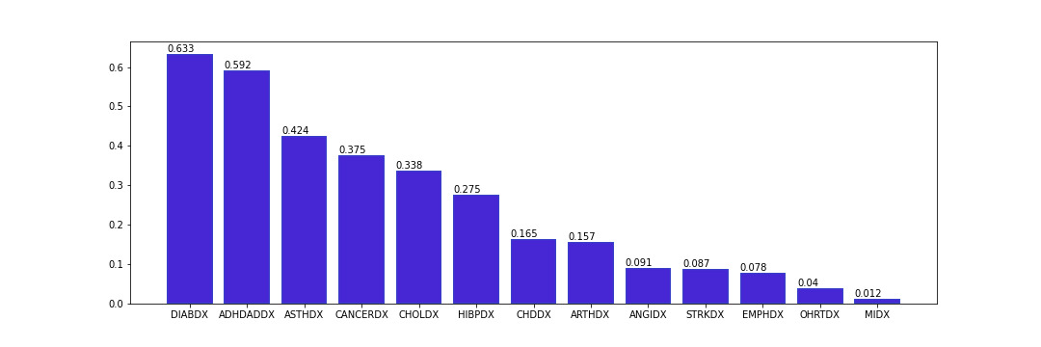
Analyzing mean SHAP values for disease variables
Reduce costs by $5M through many improvements
Saving $3M
Saving $1M
Saving $1M
Evaluate cost and
service levels
Select non-core functions
Choose one partner for each function
Design current processes
Current process to best-in-class benchmarks
Adopt best practices based on benchmarks
Select current costs
Evaluate cost of alternative suppliers
Negotiate supplier contracts options
Notes:
This is the analysis of mean SHAP values for variables describing various diseases, rounded to 3 decimal points.

Slide 18
Analyzing mean SHAP values for disease variables
Higher SHAP values for long-term diseases
Diabetes (DIABDX)
ADHD/ADD (ADHDADDX)
Asthma (ASTHDX)
Notes:
We find higher values for long-term diseases such as diabetes, ADHD/ADD, and asthma, which require constant treatment and medication.

Slide 19
Analyzing mean SHAP values for disease variables
Lower SHAP values for long-term diseases
Coronary Heart Disease (CHDDX)
Other Heart Diseases (OHRTDX)
Heart Attack (MIDX)
Notes:
On the other hand, lower SHAP values are observed for heart diseases, including coronary heart disease, other heart diseases, and heart attacks.

Slide 20
05
Conclusions

Slide 21
Decisions: new market, product & company
Difficulty in judging knowledge revealed by XAI methods
Generalized final conclusions
Conclusions
Key Findings
Considerations
Notes:
While some conclusions seem certain, it's challenging to judge if the knowledge revealed by XAI methods is accurate or just an artifact in the model or data, particularly when model performance isn't very high.

Slide 22
Decisions: new market, product & company
XAI methods useful in identifying outliers
14% of patients with questionable zero
expenditures
XAI algorithms transform complex models into simpler models
SHAP for encoding and grouping variables
Key Findings
Considerations
Conclusions
Notes:
Our analysis shows that XAI methods can be useful in identifying outliers and transforming complex models into simpler, self-interpretable models using SHAP.

Slide 23
Decisions: new market, product & company
Explaining instances and models may not provide correct answers
Often helps in asking the right questions
Considerations
Conclusions
Key Findings
Notes:
However, it's important to note that trying to explain instances and models won't always provide correct answers, but in most cases, it will help us ask the right questions.

Slide 24
Thanks!
Does anyone have any questions?
Story MEPS 7

